Slide 1

Smart Menu Solution Project
Evaluation Schemes

Slide 2



1
Introduction
2
Hardware
3
Software
4
Conclusion

Slide 3

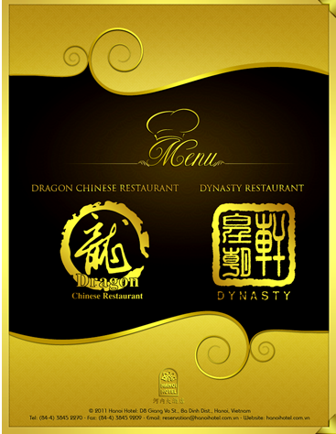
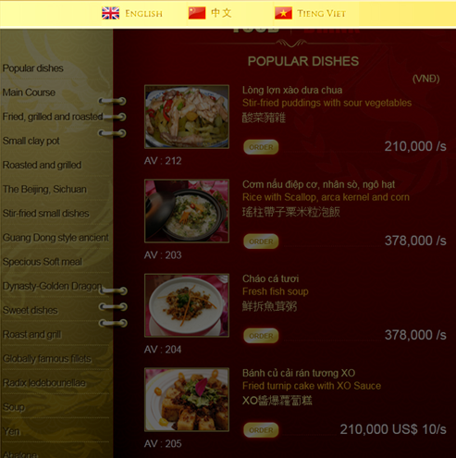
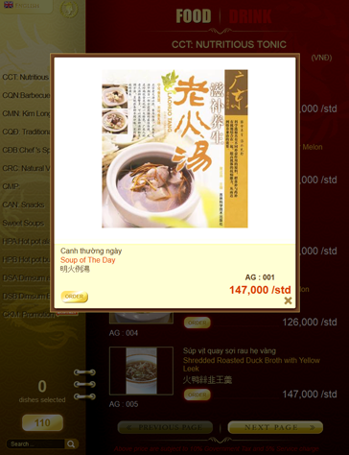
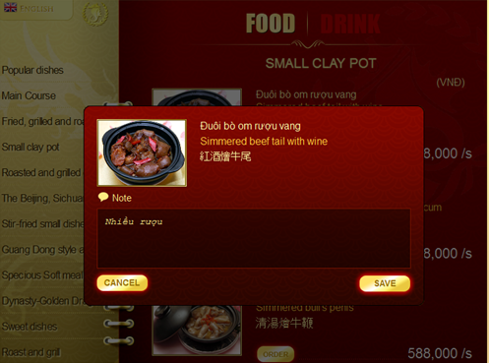
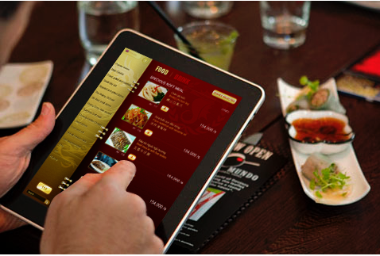
View price.
Choose dishes.
See a real image about this food.
Additional requirements
System provides 3 language:
  Chinese
  English
  Vietnamese
  → Expand customer’s range

Slide 4
Smart Menu Software in Viet Nam:
 | iMenu | ezMenu
Support Handle Mobile | V | V
Support Multi Languages | V | V
Call waiters | V | V
Custom comment for dishes | V | V
Cancel dishes | V | V
View dishes status |  | V
Print billing | V | V
Auto distribute dishes |  | V
Chef configuration |  | V
Software management in PC | V | V
Custom menu | V | V
Existing System’s Functions

Slide 5

Actual needs:
  Lost time for waiting to note orders.
  Have errors and lead to debate later when notes by papers.
  Lost money and hard to control a lots waiter.
None of the existing system is widely applied in Viet Nam because:
  Price,
  Functionality,
  Usability, etc.
→ The market is still available for our product.
Notes:
Smart Menu Solution (SMS): Calling dishes system in the restaurant, call SMS, is the innovative solutions and effective in serving customers. The system will meet the immediate needs of customers, helping them happy, satisfied with the way the restaurant serves. All processes from customers to choose the dish, move the menu down the kitchen, the chef made ​​dishes, transferred to waiters to bring, call billing, receipt printer ... the system are carried out automatically by the application of information technology and electronics.

Slide 6

Kitchen
Cashier
SMR
Sever PC
Printer
Display
Show list dishes have to cook
1
2
3
4
5
6
7
8
9
SMC device: inform dishes has done
1
2
3
4
5
6
7
8
9
Restaurant space and SMO devices
1
2
3
…
1
2
3
4
5
6
4
5
6
7
8
9
7
8
9
SMO
Global Picture of Project
Notes:
Client order dishes by using SMO. They enter the dish ID, quantity. Then they confirm their input, SMO will send the ordered data to SMR.
After SMR receive the data from SMO, it transfers that data to the server PC with order information about table ID, dish ID, quantity. An application in computer will use algorithm to sort the order base on priority and transfer that list to the kitchen.
The list includes information about dish name and quantity then will be displayed on a screen at the kitchen. The chiefs will make the dishes base on that list. In case a client cancel some dishes, kitchen will be inform and host need their confirmation to actually cancel a dish.
When a dish is finished, the PC server will be notified via the SMC device in the kitchen. A waiter brings dishes to the client.
After customers finish their meal, the customer can inform the PC server to print the bill. A waiter only needs to bring that bill to the customer and collect the bill.

Slide 7


Expectations:
  Providing the basic function of ordering, billing and statistic.
  Providing new electric device to order dishes
  Providing Window management software to manage orders, billing and automatic distribute dishes to chef.
  Stability.
  Acceptable price.

Slide 8
2. Available features:
  Use SMO to select the menu.
  Support two language: English or Vietnamese.
  View the status of dishes.
  Cancel dishes before it’s done.
  Call waiters at any time with just one click.
  Do not waiting for cash requirements, receipt printer
  Transfer orders to chef after marking priority.

Slide 9

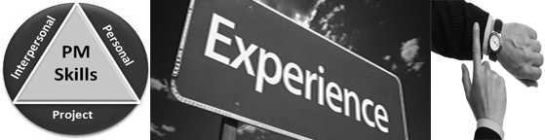
Lack of experience when works on real projects.
Lack of project management skill, experience.
Work in tester position not as well as.
Lack of facilitation for developing the project (place, equipment, etc.)
Lack of experiences of estimating time and budget for developing project.

Slide 10

SMS Basic | SMS Professional (coming soon…)
- Serve in small restaurant, cafe shop, diner shop. - Have cheap price. - Provide simple electric device to select dishes called SMO. - Have all basic functions. - Do not comment about dishes. - Need paper menu. | - Serve in large restaurant. - Have expensive price. - Provide software in tablet (Embedded computer running Android OS) called SMT. - Have all basic functions. - Can comment about dishes. - Do not need paper menu.
Scope of product

Slide 11

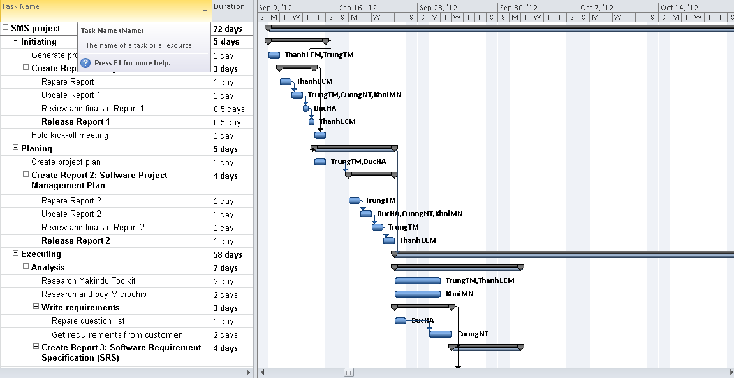

Slide 12


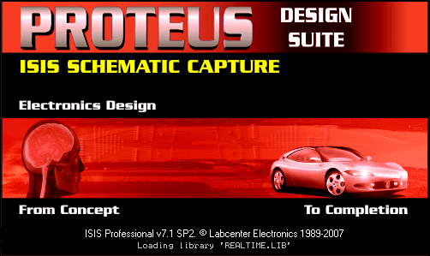

Slide 13
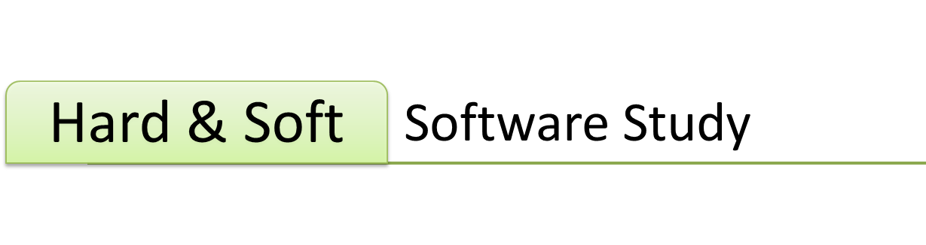



Slide 14
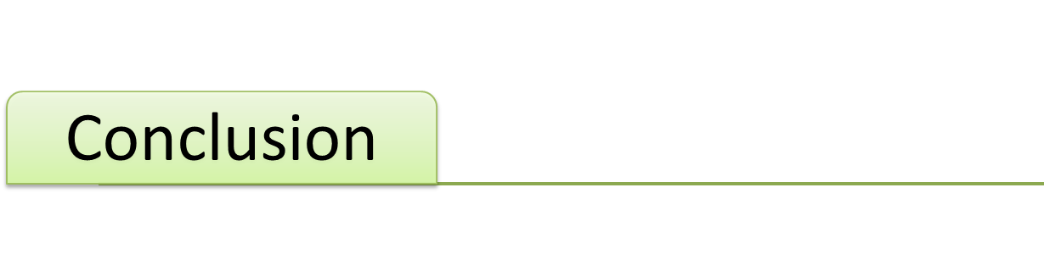
Q&A

Slide 15
Thank you
for your attention!

